Slide 1



Electronics Sales Analysis Using Python

Slide 2
Introduction
In this project I used Python Pandas & Python Matplotlib to analyze and answer business questions about 12 months worth of sales data. The data contains hundreds of thousands of electronics store purchases broken down by month, product type, cost, purchase address, etc.
WPS
]

Slide 3
Background Information:
We start by cleaning our data. Tasks during this section include:
- Drop NaN values from DataFrame
- Removing rows based on a condition
- Change the type of columns (to_numeric, to_datetime, astype)
Once we have cleaned up our data a bit, we move the data exploration section. In this section we explore 5 high level business questions related to our data:
- What was the best month for sales? How much was earned that month?
- What city sold the most product?
- What time should we display advertisemens to maximize the likelihood of customer’s buying product?
- What products are most often sold together?
- What product sold the most? Why do you think it sold the most?
To answer these questions we walk through many different pandas & matplotlib methods. They include:
- Concatenating multiple csvs together to create a new DataFrame (pd.concat)
- Adding columns
- Parsing cells as strings to make new columns (.str)
- Using the .apply() method
- Using groupby to perform aggregate analysis
- Plotting bar charts and lines graphs to visualize our results
- Labeling our graphs

Slide 4
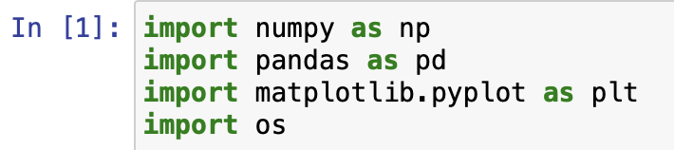
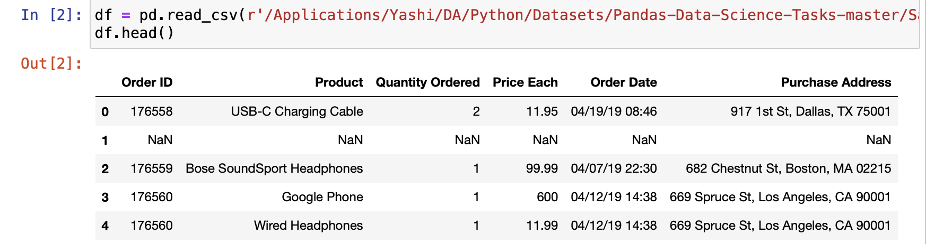
Import Statements -
Reading the data -

Slide 5
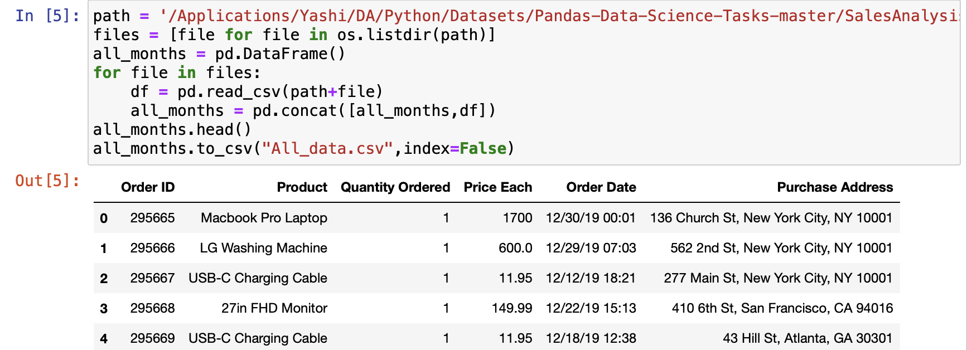
Task 1 : Merging 12 months of data into a single file

Slide 6
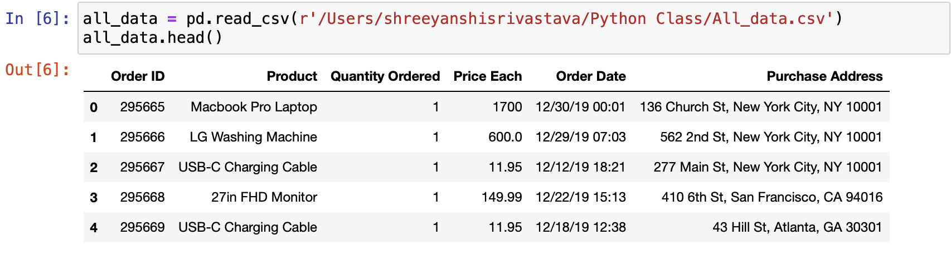
Read in updated dataframe

Slide 7
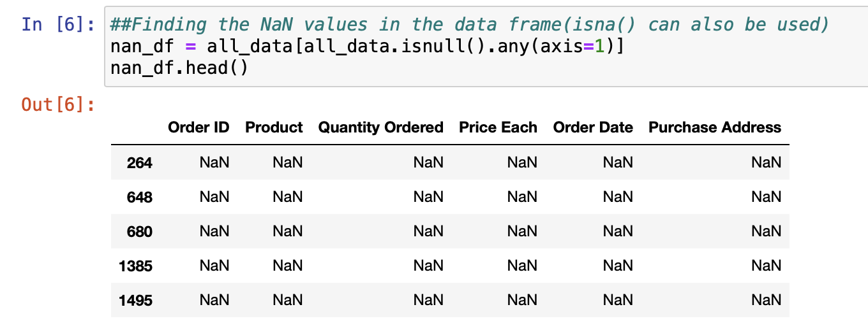
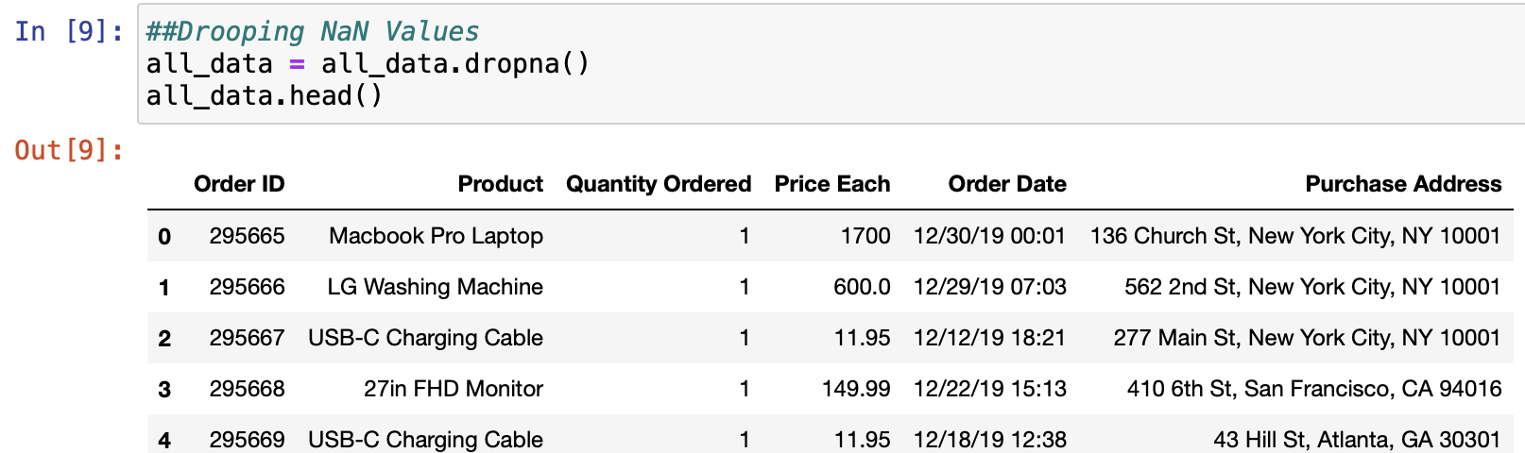
Task 2 : Clean up the data! The first step in this is figuring out what we need to clean. I have found in practice, that you find things you need to clean as you perform operations and get errors. Based on the error, you decide how you should go about cleaning the data.

Slide 8
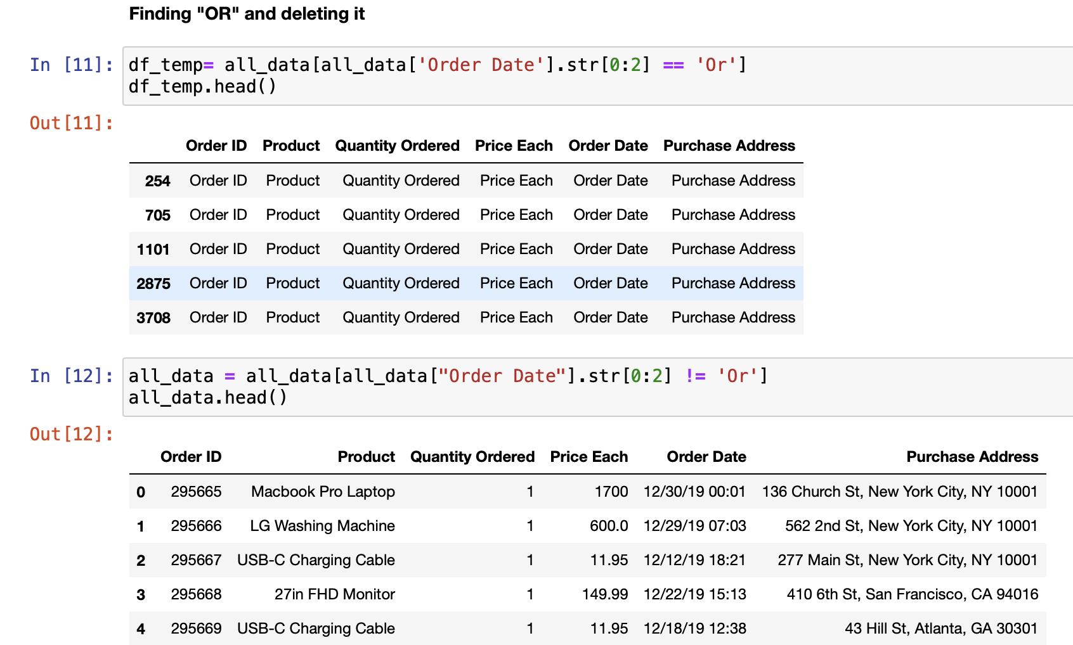
Get rid of text in order date column

Slide 9
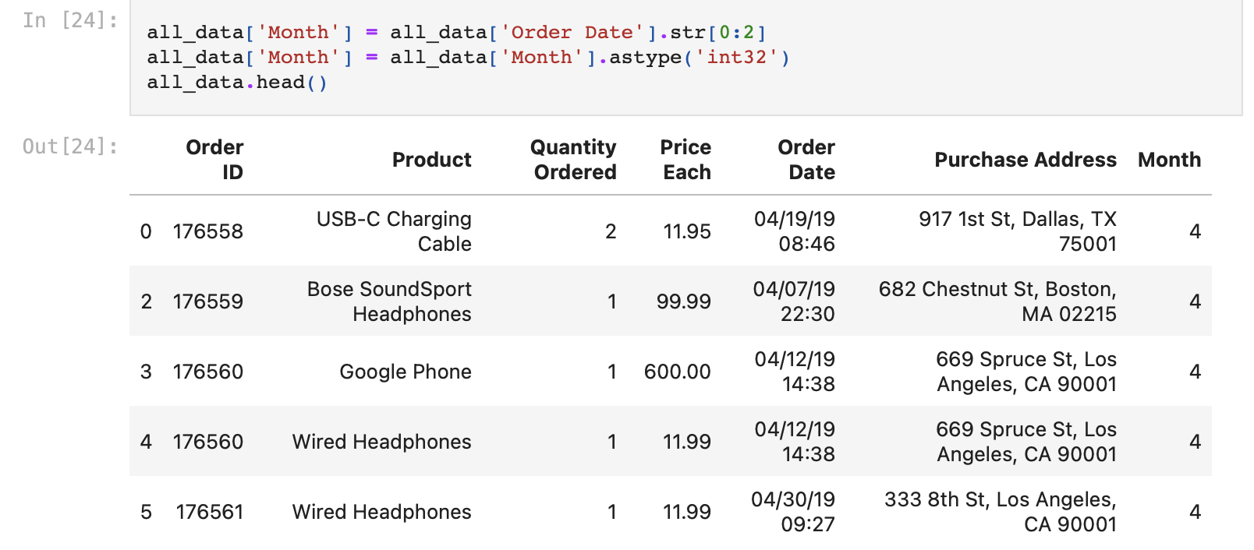
Task 3: Make columns correct type
Task 4: Add month column

Slide 10
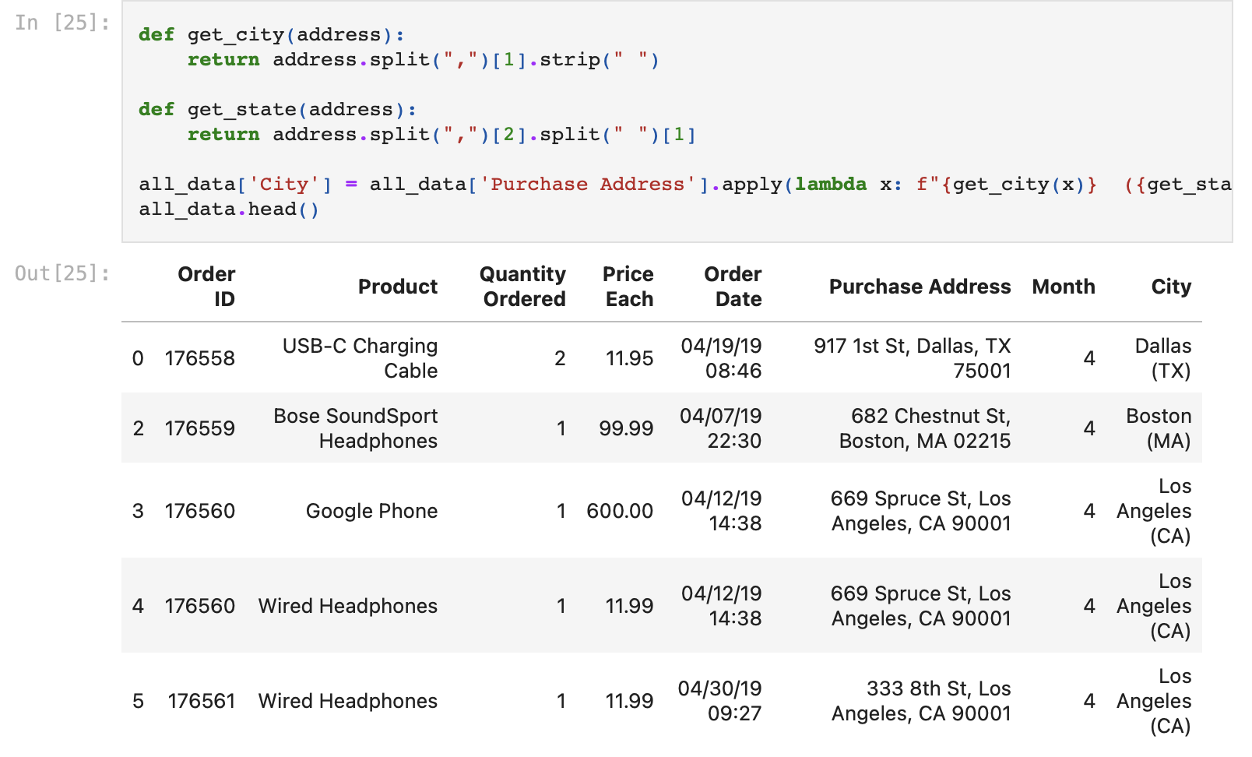
Task 5: Add city column

Slide 11
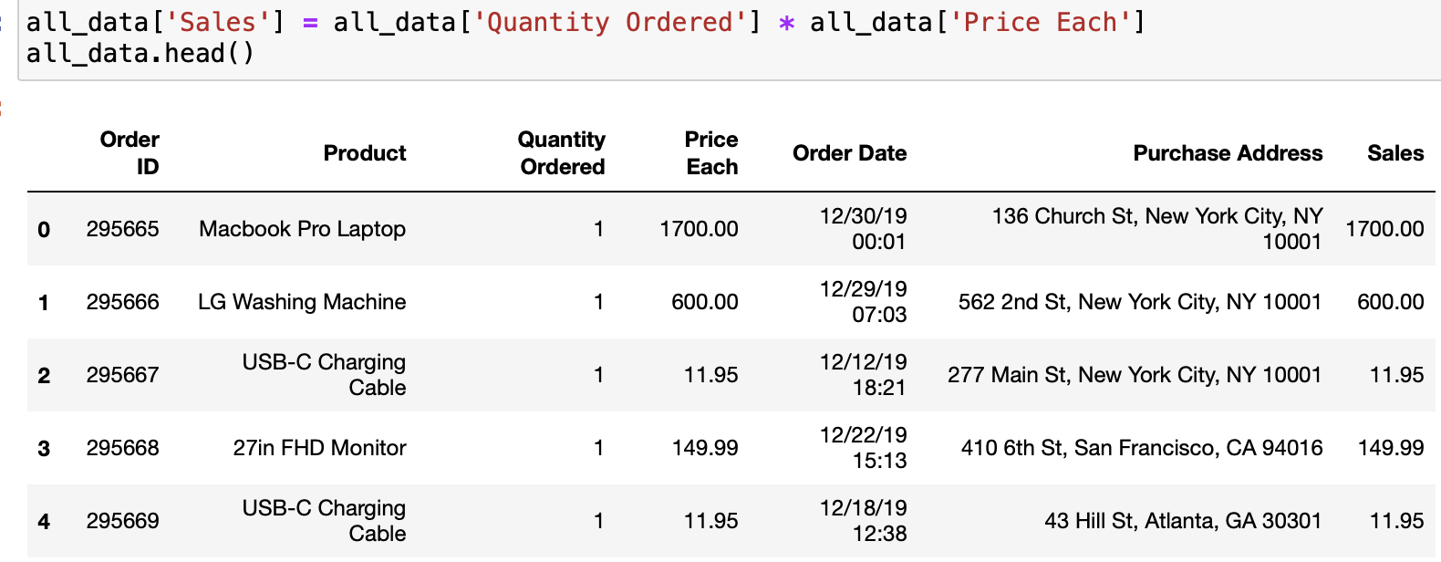
Data Exploration! Question 1: What was the best month for sales? How much was earned that month?

Slide 12
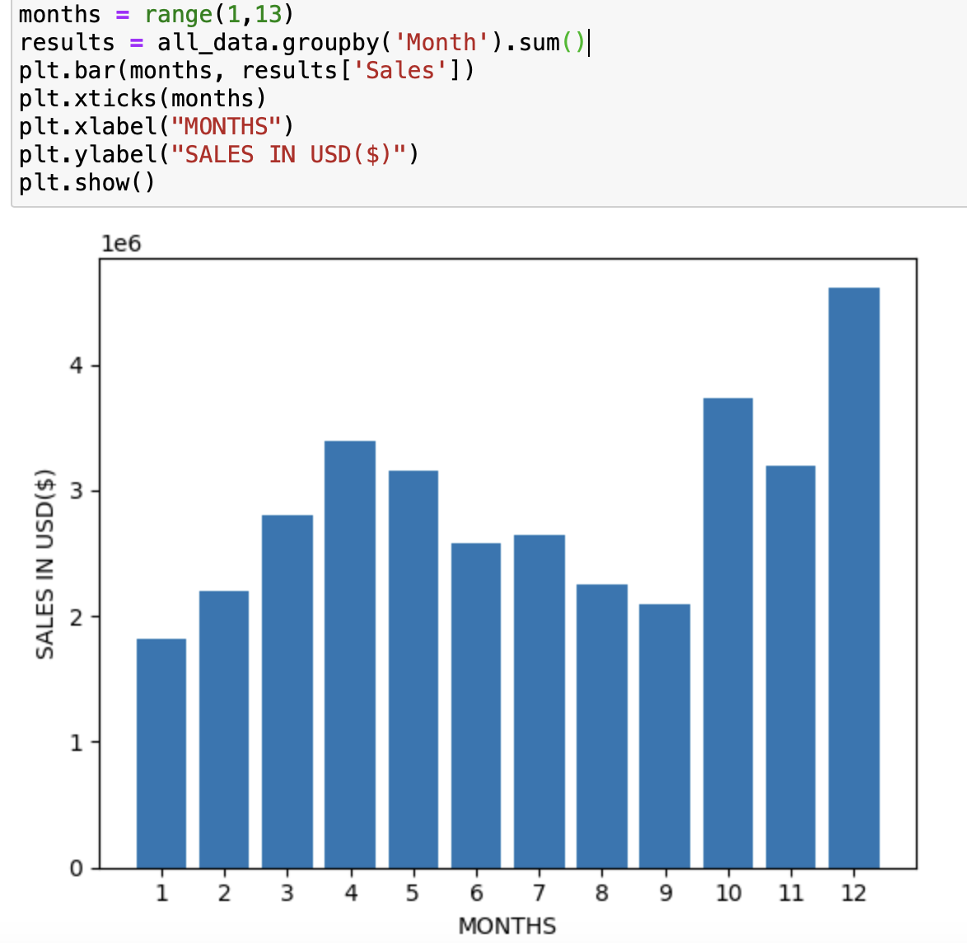
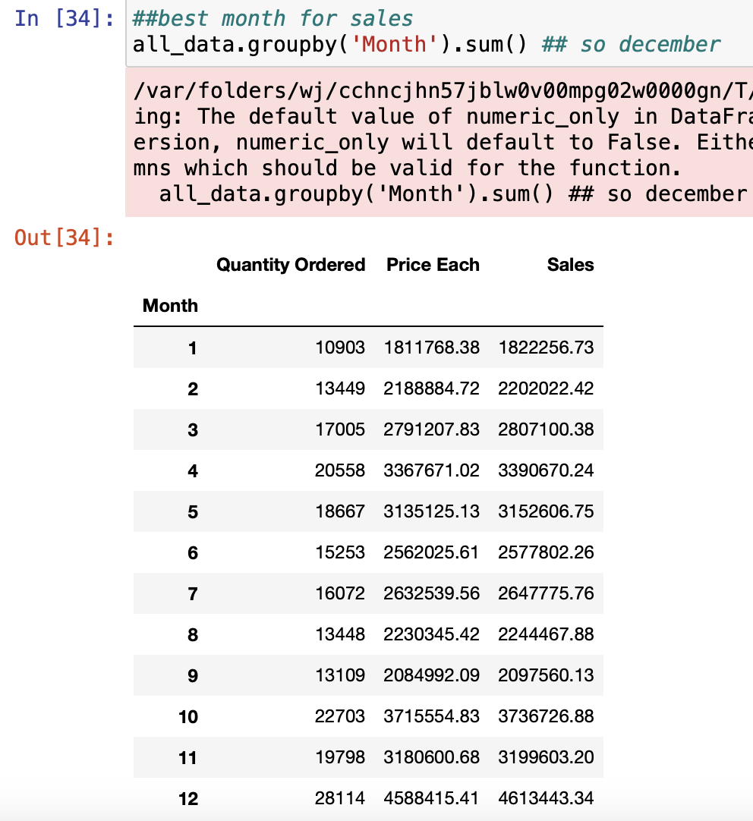

Slide 13
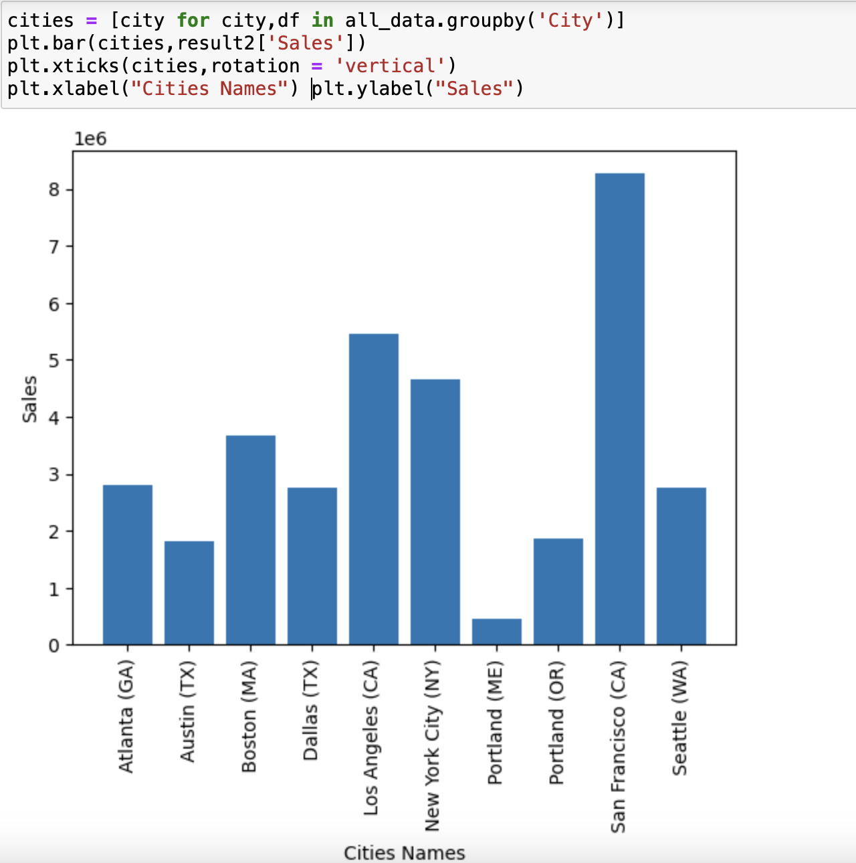
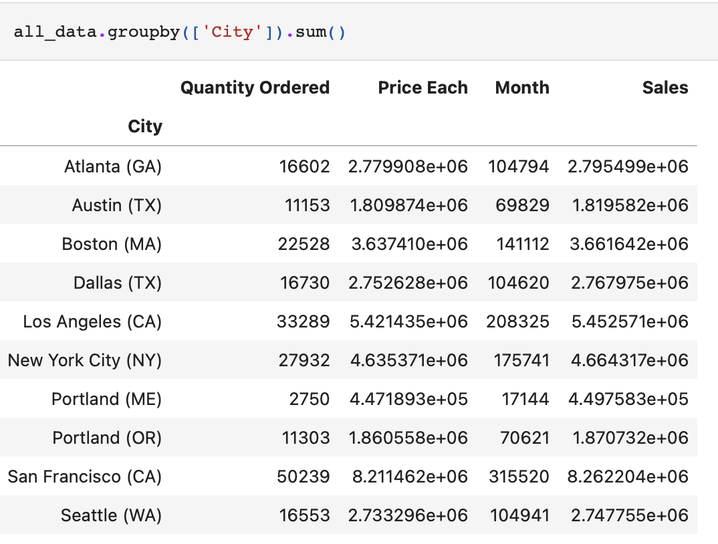
Question 2: What city sold the most product?

Slide 14
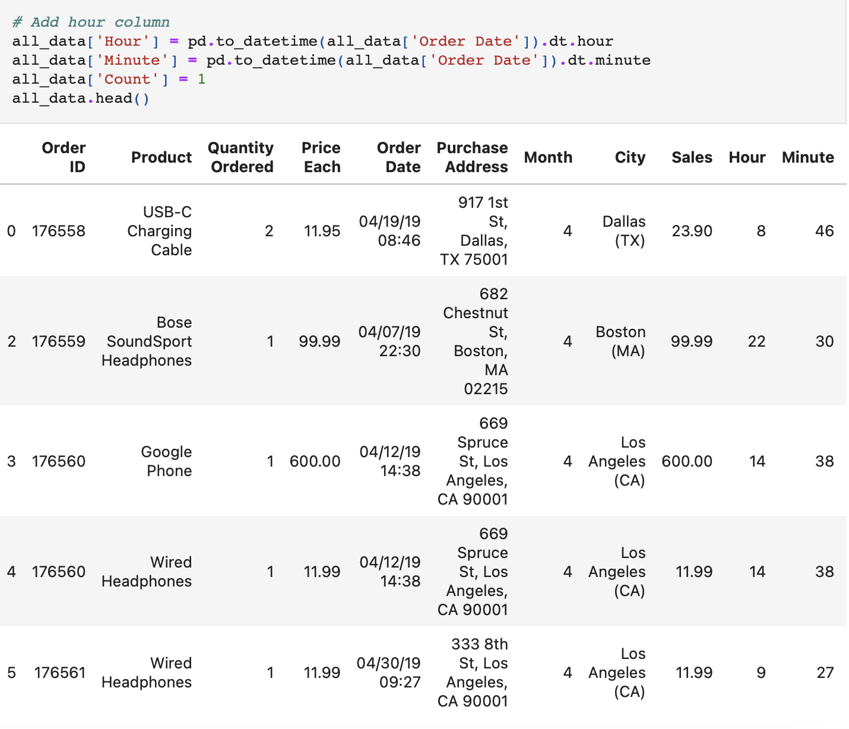
Question 3: What time should we display advertisements to maximize likelihood of customer's buying product?

Slide 15
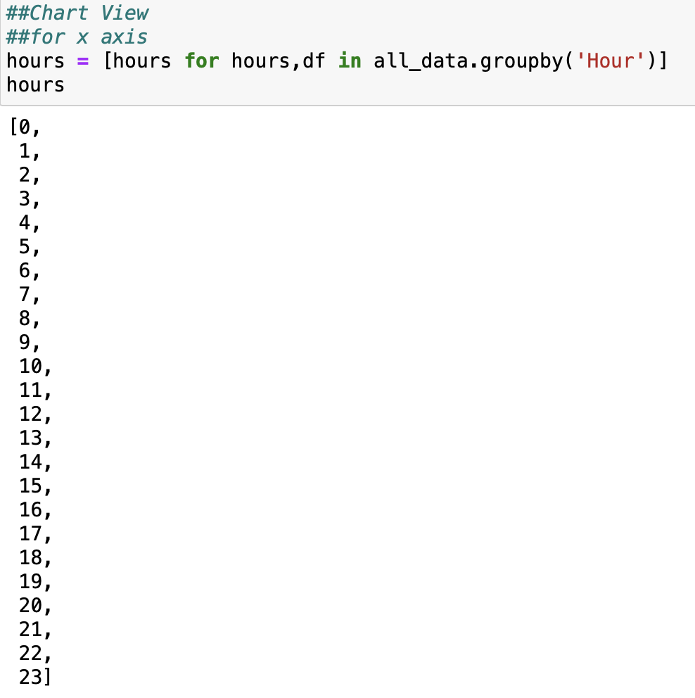
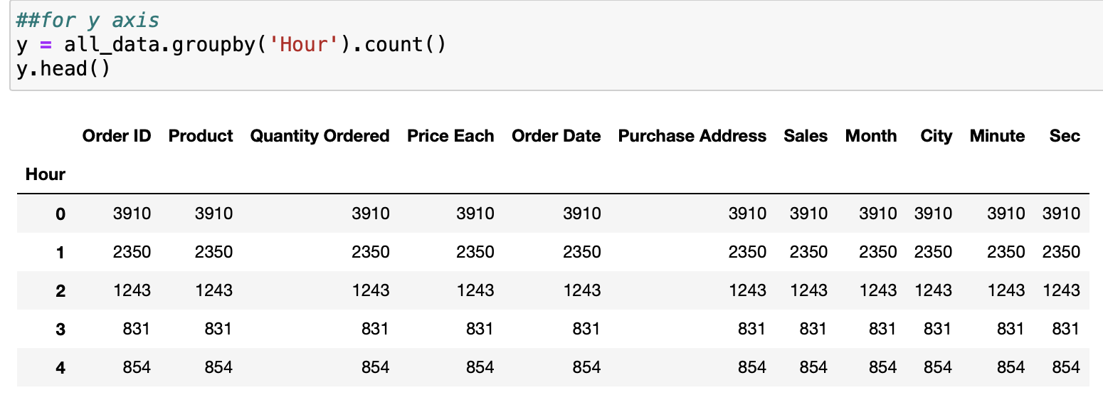
Plotting Graph - Finding out x and Y values

Slide 16
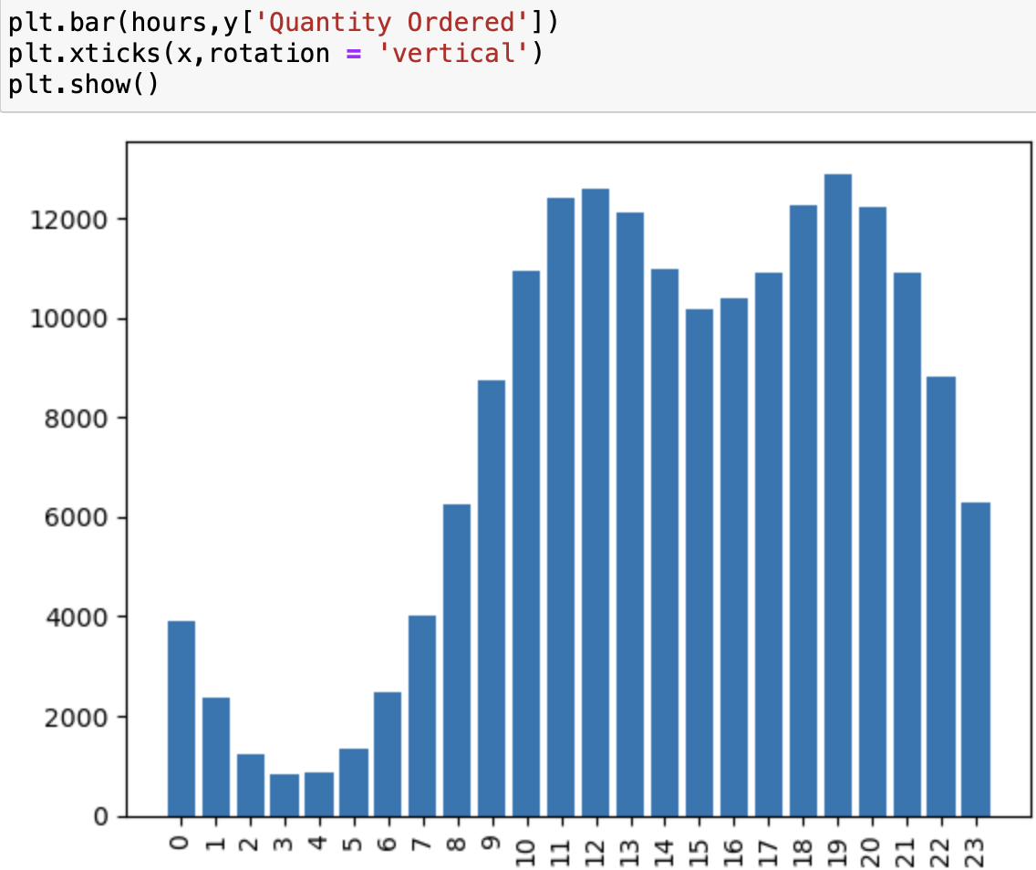
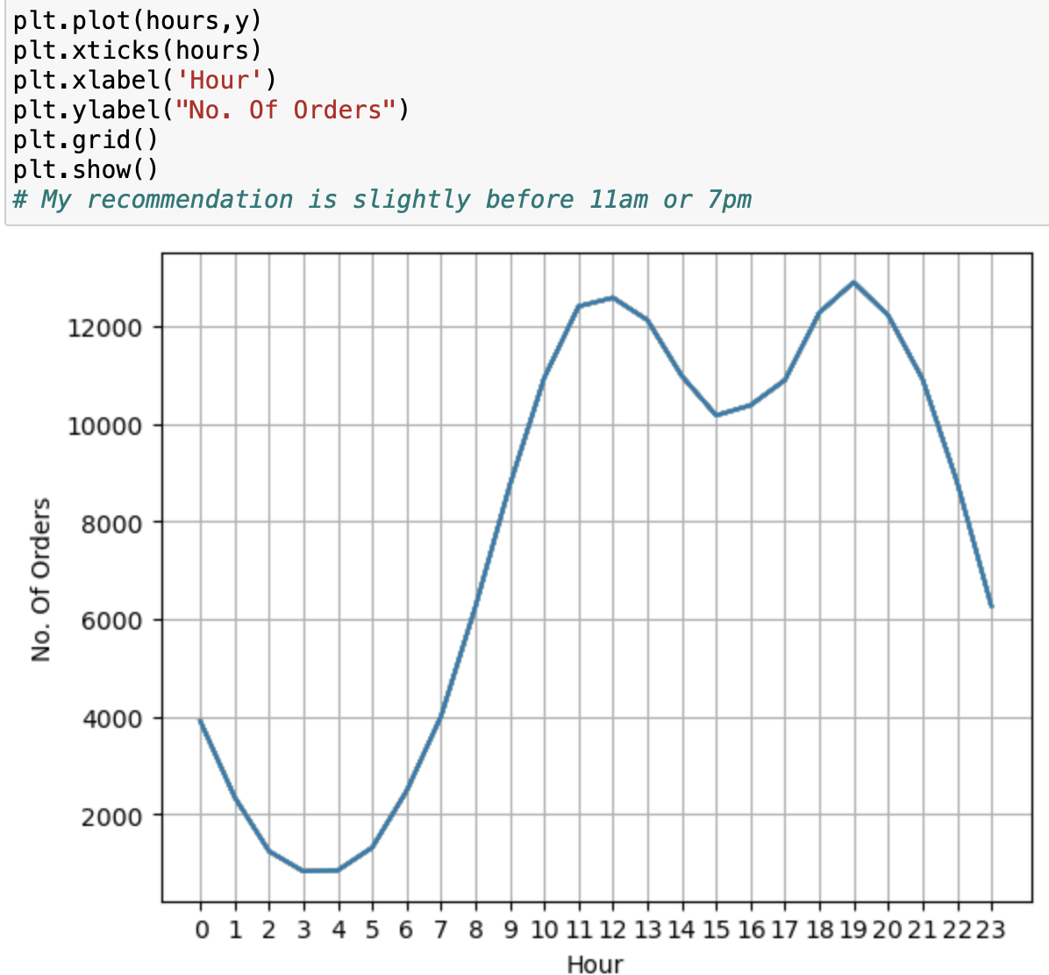

Slide 17
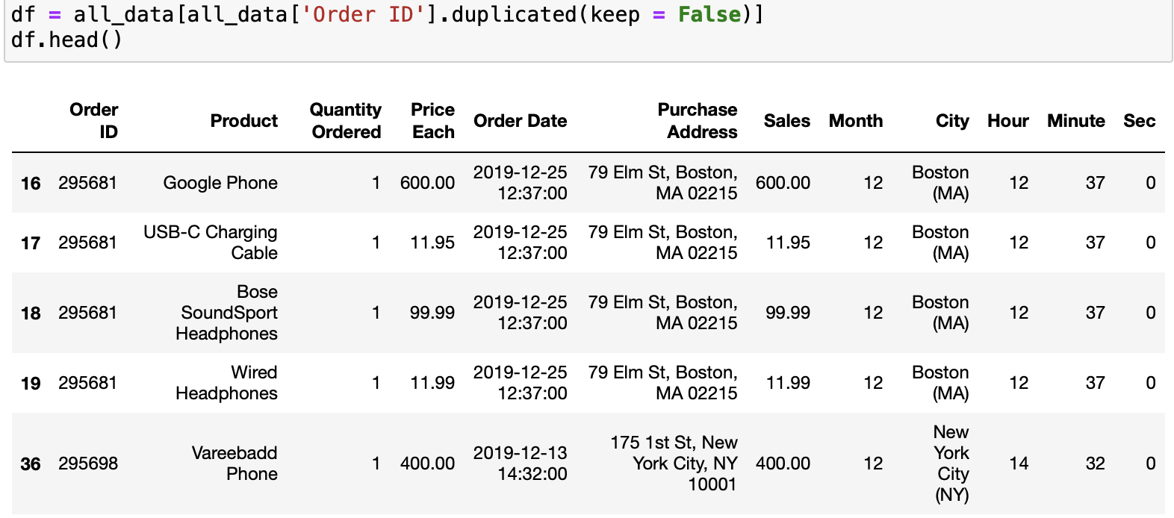
Question 4: What products are most often sold together?
a) Finding the duplicate order id

Slide 18
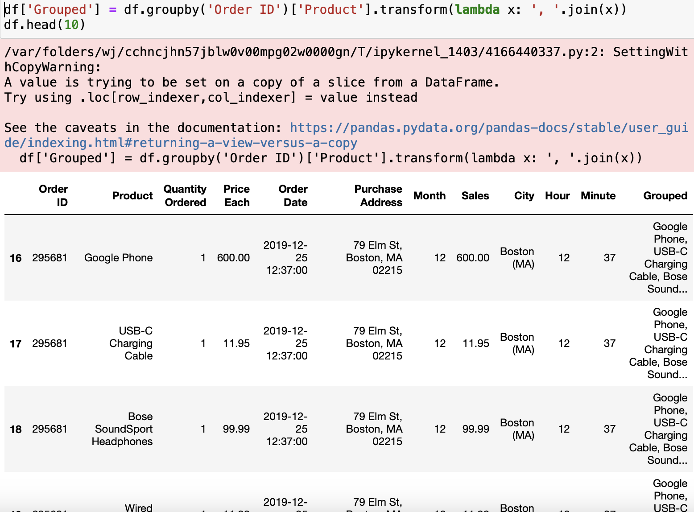
Creating a new column where we will store these duplicated Product values

Slide 19
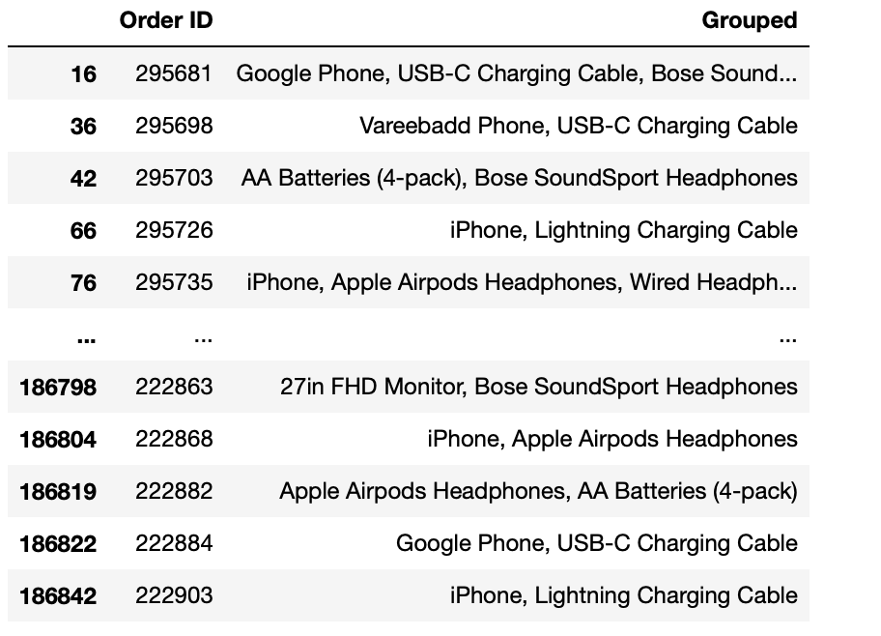
In the above table, we need to see the grouped columns only once

Slide 20
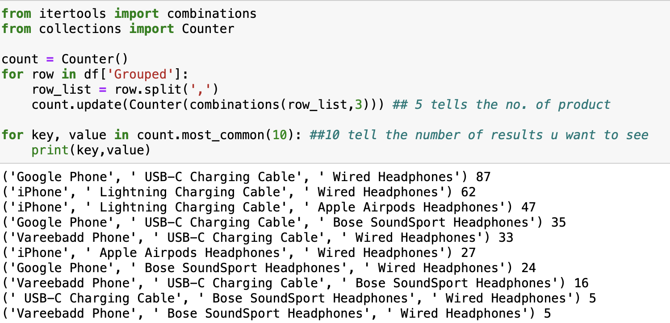
For getting the total no. of products buyed together

Slide 21
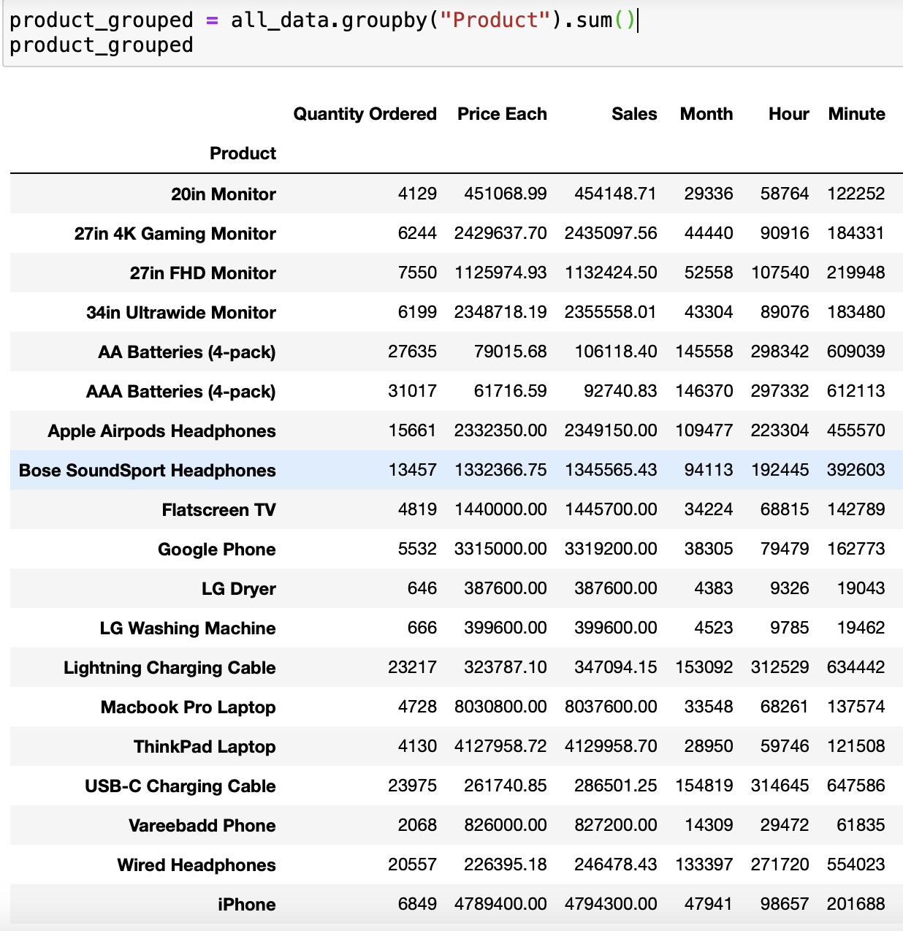
Question 5: What product sold the most? Why do you think it sold the most?
So, the product which is ordered the most is our answer. By the below query we can see i.e. AAA Batteries (4-pack)

Slide 22
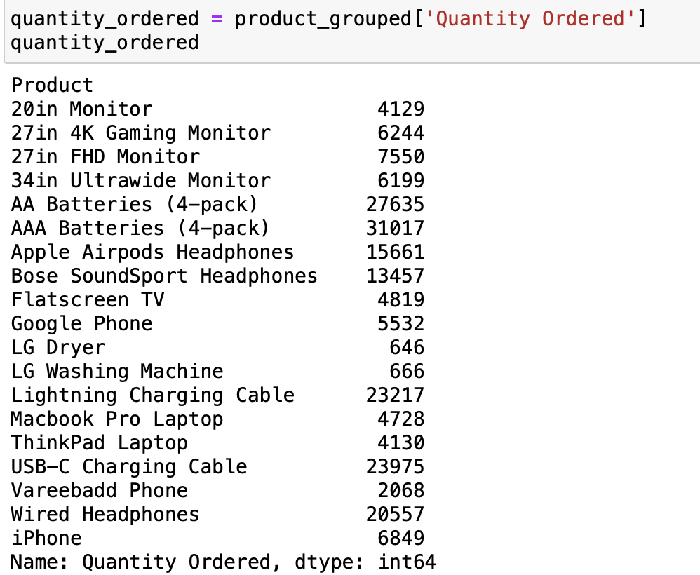
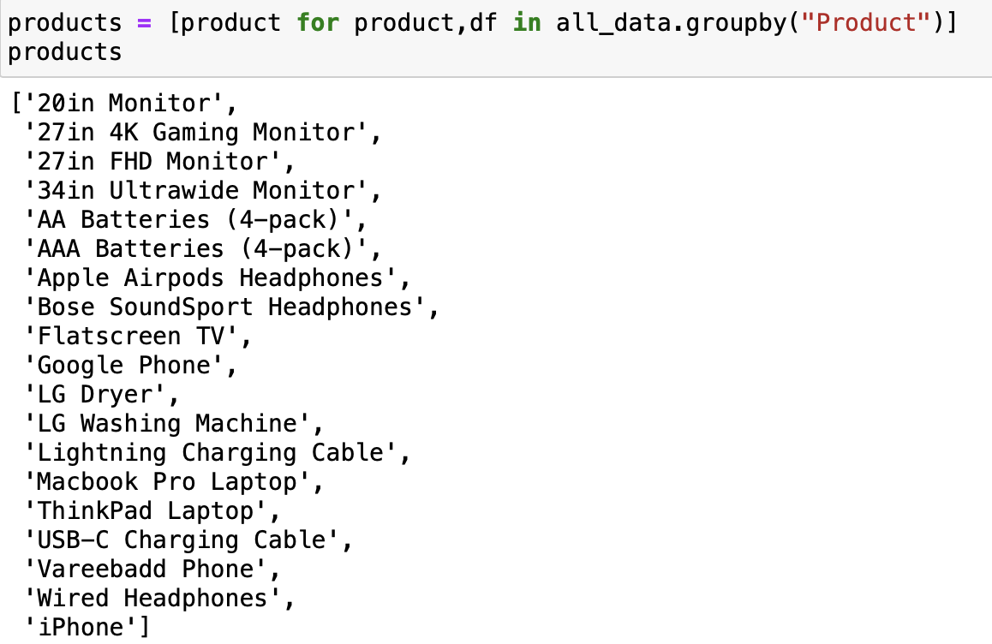
Finding x and y values to plot this in graph

Slide 23
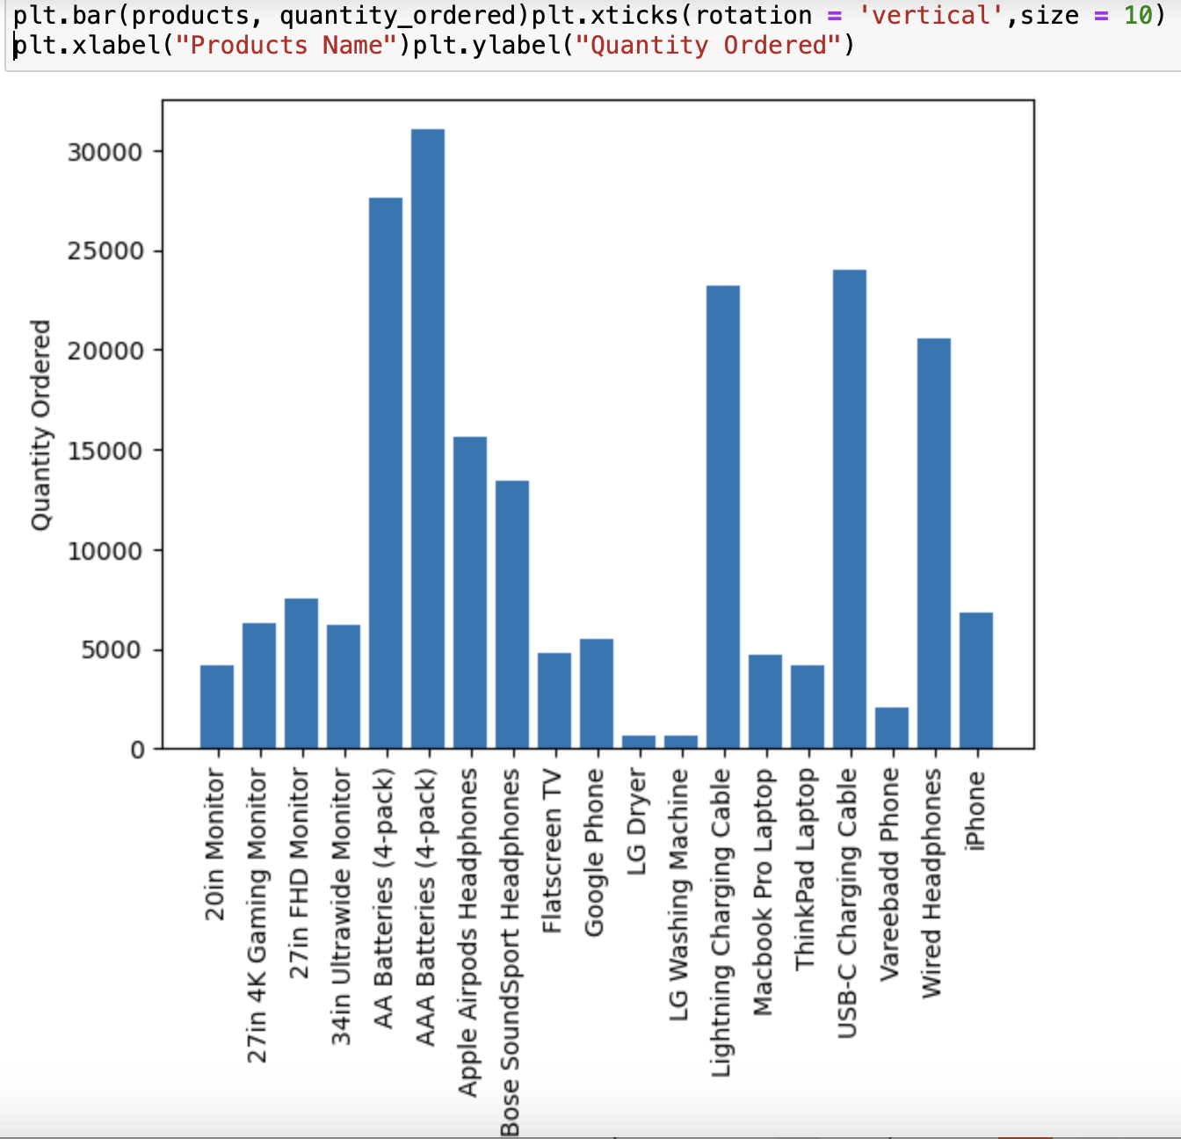
Graph

Slide 24
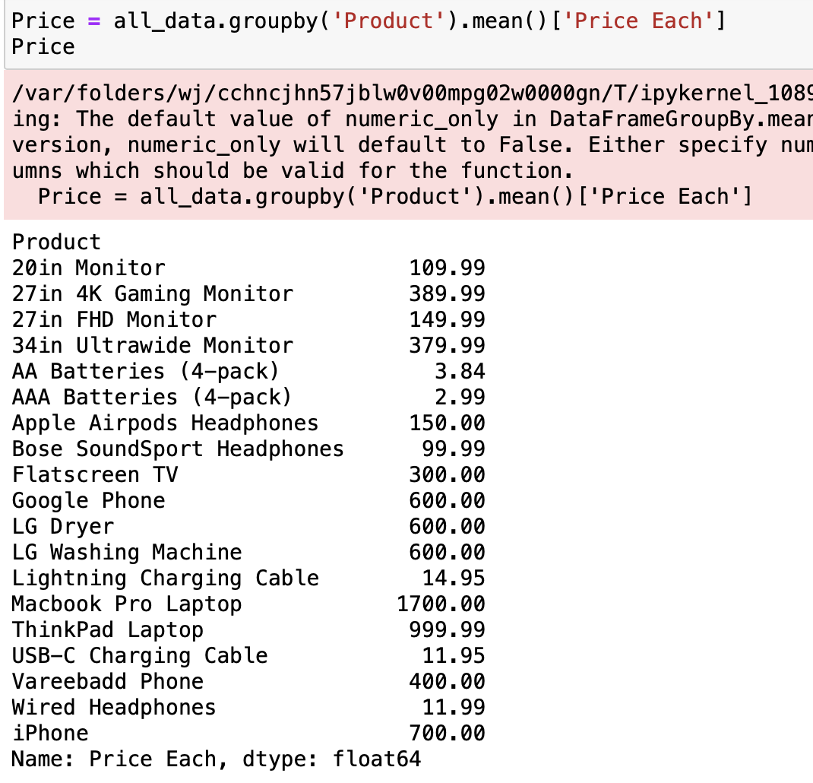
To answer the question why we think so that AAA battery have the most sales we will plot the price graph on the other end

Slide 25
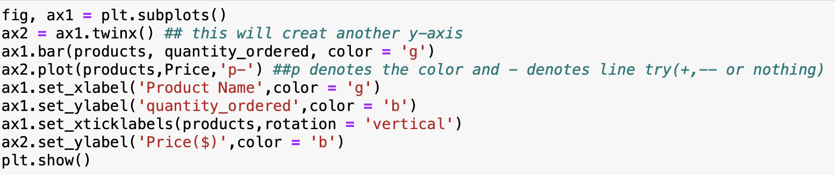
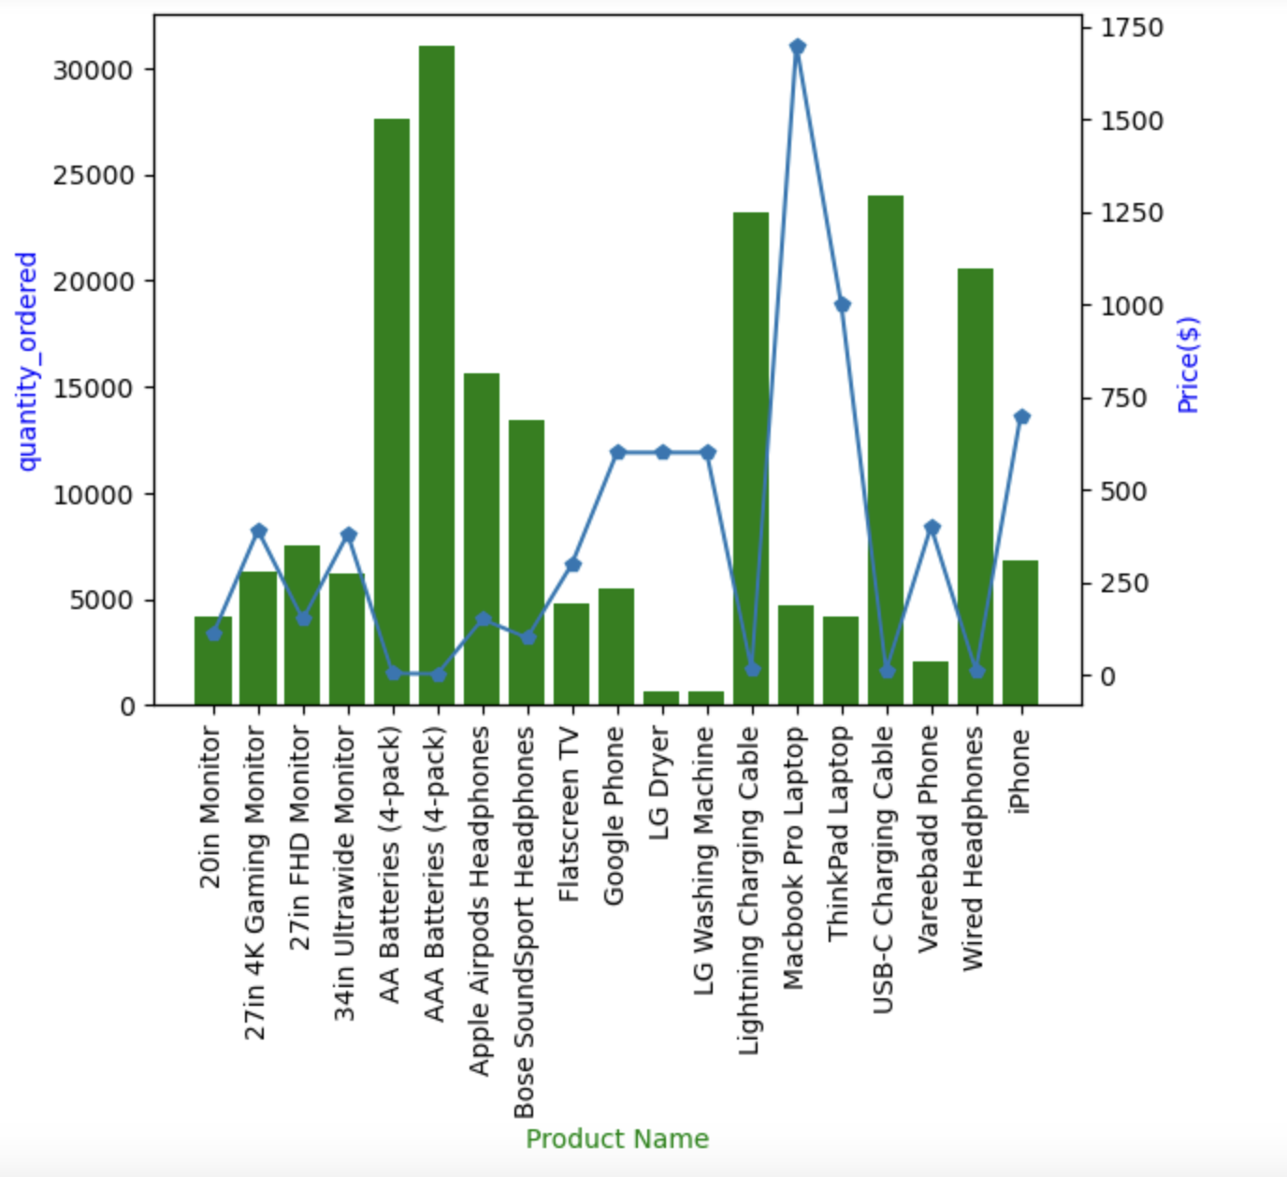

Slide 26
WPS
THANK YOU

